Slide 1
2.5 Array
ITP3914 – Programming
Part 2 – Concepts of Data Types and Operations

Slide 2

Part 1 – One-Dimensional Array

Slide 3
Naïve Approach
import java.util.*;
public class Naive {
public static void main(String [ ] args) {
Scanner keyboard = new Scanner(System.in);
int grade1, grade2, grade3, grade4;
double average;
grade1 = keyboard.nextInt();
grade2 = keyboard.nextInt();
grade3 = keyboard.nextInt();
grade4 = keyboard.nextInt();
average = (grade1 + grade2 + grade3 + grade4) / 4.0;
System.out.println("Average = " + average);
}
}
The program works if there are only four students.
What if there are 100 students?
Declare 100 variables?

Slide 4
What is an array?
An array is a collection of related data being put together.
one single name
same data type
indexed with an integer
mark[0]
89
mark[1]
76
mark[2]
34
mark[3]
85
mark[4]
65
mark[5]
46
System.out.print ( mark[0] );
89
mark[6]
64
System.out.print ( mark[4] );
65
mark[7]
56
mark[8]
90
mark[8] = 88;
88
mark[8] = 88;
System.out.print ( mark[8] );
88
mark[9]
42

Slide 5
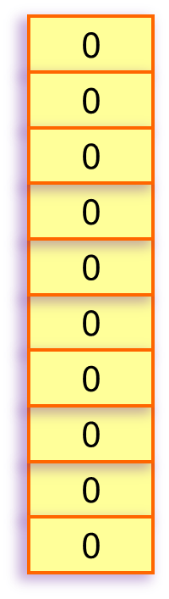
Creating an Array
An array must be created before it can be used.
Creating an int variable
int num;
int num = 10;
num
10
int
data type
variable name
Creating an int array
int [ ] mark;
int [ ] mark = new int [10];
mark
int [ ]
create an array having 10 elements for storing int values
Elements in a numerical array will be initialized to 0.

Slide 6
Array Initialization
myArray[0]
13
public class ArrayInitEg {
public static void main(String [ ] args) {
int [ ] myArray = { 13, 6, 2, 90, 78 };
}
}
myArray[1]
6
myArray[2]
2
myArray[3]
90
myArray[4]
78
An array is created though there is no “new” operator.
Java counts the number of initial values and determines the size of the array.
The initial values are put inside the array automatically.

Slide 7
Array Bounds
public class ArrayBoundEg {
public static void main(String [ ] args) {
int [ ] myArray = { 13, 6, 2, 90, 78 };
System.out.println ( myArray[1] );
System.out.println ( myArray[2] );
System.out.println ( myArray[3] );
System.out.println ( myArray[4] );
System.out.println ( myArray[5] );
}
}
myArray[0]
13
myArray[1]
6
myArray[2]
2
myArray[3]
90
myArray[4]
78
c:\> java ArrayBoundEg
6
2
90
78
Exception in thread "main" java.lang.ArrayIndexOutOfBoundsException: 5
at ArrayBoundEg.main(ArrayBoundEg.java:8)
Error occurred when attempting to access myArray[5]

Slide 8

Processing array using a loop
public class ArrayLoop {
public static void main(String [ ] args) {
int [ ] myArray = { 13, 6, 2, 90, 78 };
for (int i=0; i < 5; i++)
System.out.println ( myArray[ i ] );
}
}
myArray[0]
13
myArray[1]
6
myArray[2]
2
myArray[3]
90
myArray[4]
78
Variable i changes from 0 to 4.
Thus, myArray[0], myArray[1], myArray[2], myArray[3], myArray[4] are accessed one by one.
Don’t worry! We will study for-loop in week 5.
c:\> java ArrayLoop
13
6
2
90
78

Slide 9
The .length
public class ArrayLoop {
public static void main(String [ ] args) {
int [ ] myArray = { 13, 6, 2, 90, 78 };
for (int i=0; i < myArray.length; i++)
System.out.println ( myArray[ i ] );
}
}
myArray[0]
13
myArray[1]
6
myArray[2]
2
myArray[3]
90
myArray[4]
78
myArray.length gives the number of elements in the array.

Slide 10
Dynamically allocated array
import java.util.*;
public class DynamicArray {
public static void main(String [ ] args) {
Scanner kb = new Scanner(System.in);
int size = kb.nextInt();
double [ ] array = new double[ size ];
System.out.println("Size of array=" + array.length );
}
}
c:\> java DynamicArray
5
Size of array=5
c:\> java DynamicArray
10
Size of array=10

Slide 11
Part 2 – Two-Dimensional Array

Slide 12
What is a 2D array?
A 2D array looks like a table.
rows
columns
thus needs 2 indices to identify an element.
[0]
[1]
[2]
[3]
[4]
myTable[0]
89
76
6
85
4
myTable[1]
56
24
52
90
85
myTable[2]
3
11
34
23
62
88
myTable[3]
19
63
18
9
11
System.out.print ( myTable [0] [1] );
76
The first index refers to the row number.
System.out.print ( myTable [3] [2] );
18
myTable[2][4] = 88;
The second index refers to the column number.
myTable[2][4] = 88;
System.out.print ( myTable[2][4] );
88

Slide 13
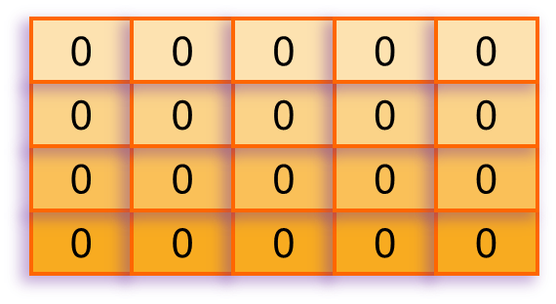
Creating a 2D Array
A 2D array must be created before it can be used.
Creating a 1D int array
int num;
list
int [ ] list = new int [10];
int [ ]
data type
variable name
Creating a 2D int array
int [ ] [ ] myTable = new int [4] [5];
int [ ] mark;
myTable
int [ ][ ]
create an array having 4 rows and 5 columns for storing int values

Slide 14
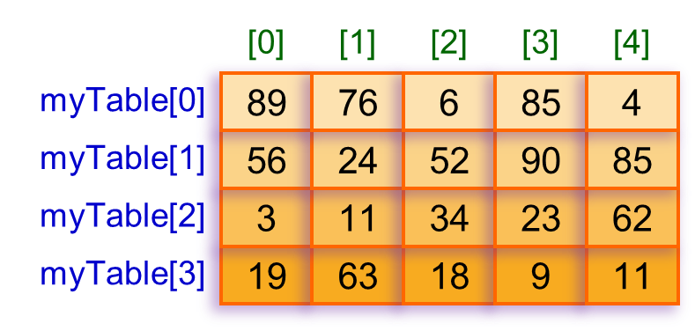
Array Initialization
public class Array2DInitEg {
public static void main(String [ ] args) {
int [ ][ ] myTable = { {89, 76, 6, 85, 4},
{56, 24, 52, 90, 85},
{3, 11, 34, 23, 62},
{19, 63, 18, 9, 11} };
}
}
A 2D array is created though there is no “new” operator.
Java counts the number of initial values and determines numbers of rows and columns.
The initial values are put inside the array automatically.

Slide 15
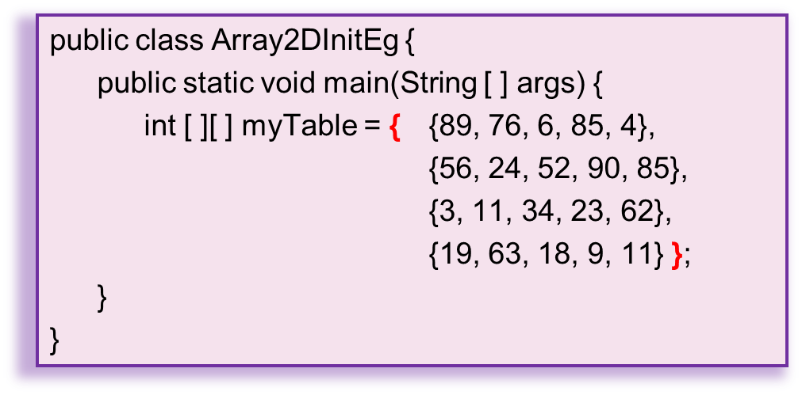
Internal Structure
myTable[0]
89
76
6
85
4
int [ ]
myTable[1]
56
24
52
90
85
int [ ]
myTable[2]
3
11
34
23
62
int [ ]
myTable[3]
19
63
18
9
11
int [ ]
A 2D array is actually a composition of multiple 1D arrays.

Slide 16
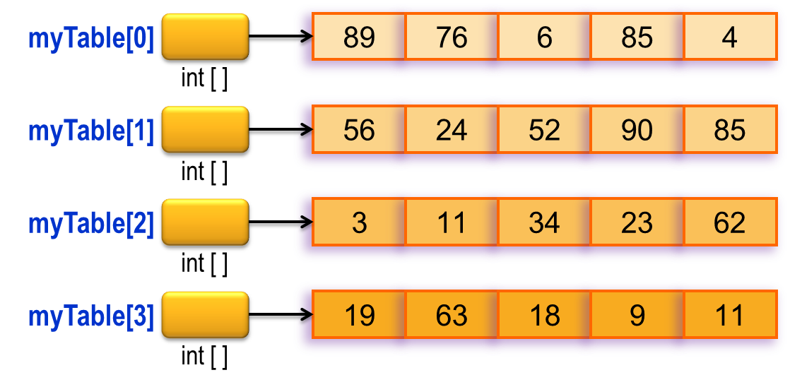
The .length
myTable[3].length gives the number of elements in the row myTable[3], that is 5.
myTable.length gives the number of rows in the 2D array, that is 4.

Slide 17
Example – .length in 2D array
public class Array2DLength {
public static void main(String [ ] args) {
int [ ][ ] myTable = { {89, 76, 6, 85, 4},
{56, 24, 52, 90, 85},
{3, 11, 34, 23, 62},
{19, 63, 18, 9, 11} };
System.out.println( myTable.length );
System.out.println( myTable[0].length );
System.out.println( myTable[1].length );
System.out.println( myTable[2].length );
System.out.println( myTable[3].length );
System.out.println( myTable[4].length );
}
}
c:\> java Array2DLength
4
5
5
5
5
Exception in thread "main"
java.lang.ArrayIndexOutOfBoundsException: 4

Slide 18
END
Programmer
Write a complete and precise set of instructions for a computer to carry out a particular problem-solving task.

